Slide 1
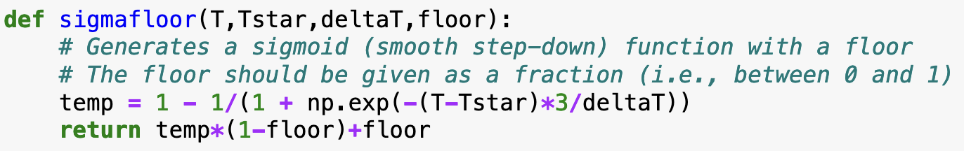
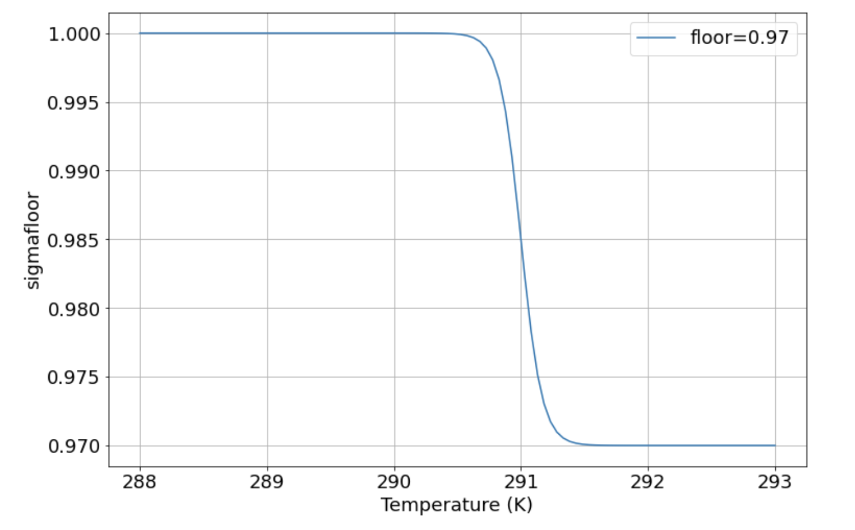
To implement certain kinds of feedbacks, we’ll need a sigmoid function
The array “T” defines the range of temperatures we’re considering (on the x-axis).
Our sigmoid function transitions from a value of 1 to a lower value when the temperature crosses a threshold value.

Slide 2
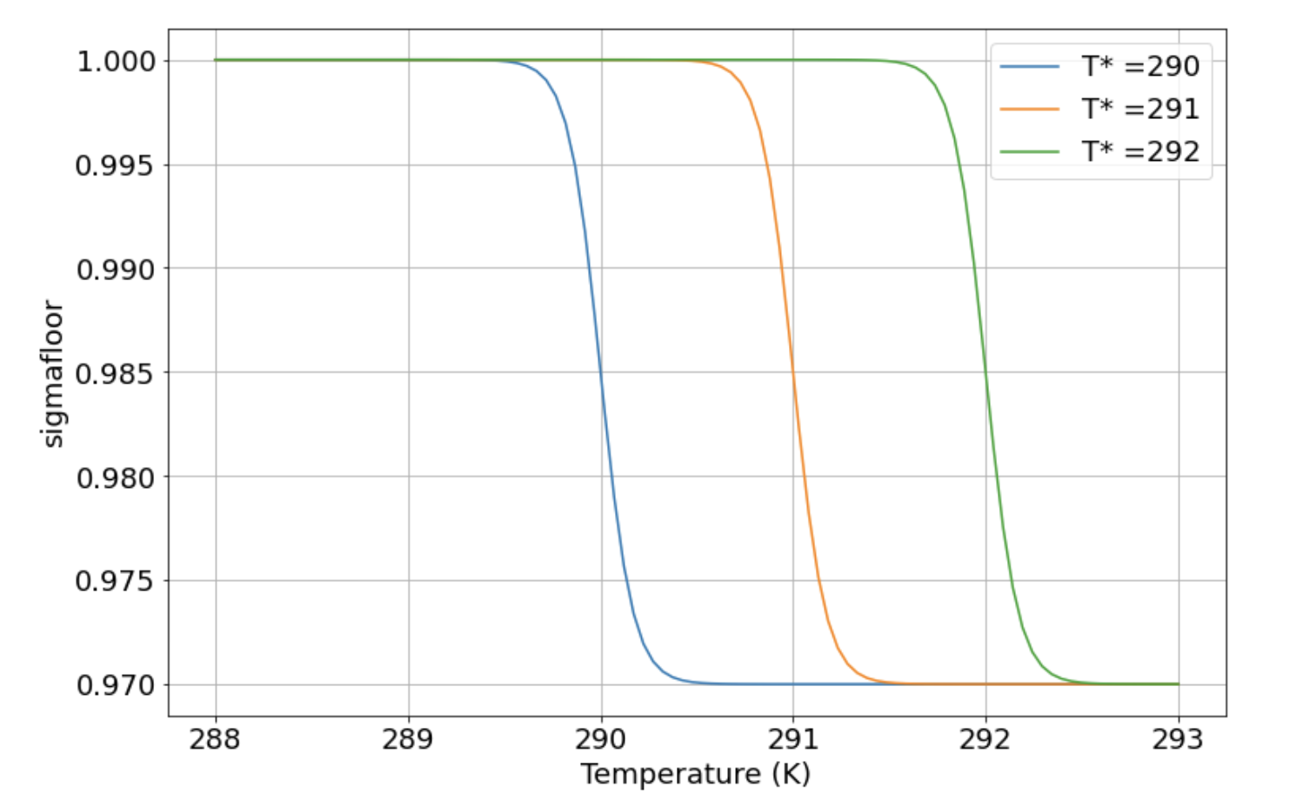
To implement certain kinds of feedbacks, we’ll need a sigmoid function
The threshold parameter is specified by the second argument, “Tstar”. Here you can see the effect of various values of “Tstar”

Slide 3
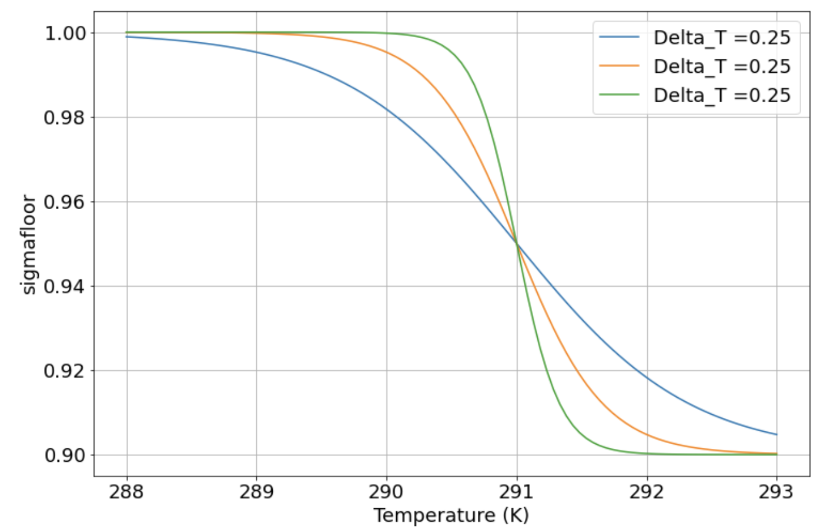
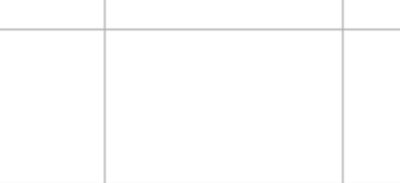
To implement certain kinds of feedbacks, we’ll need a sigmoid function
Here’s the effect of different values of the 3rd argument, “deltaT” (also referred to as “T_transition” in the Notebook)

Slide 4
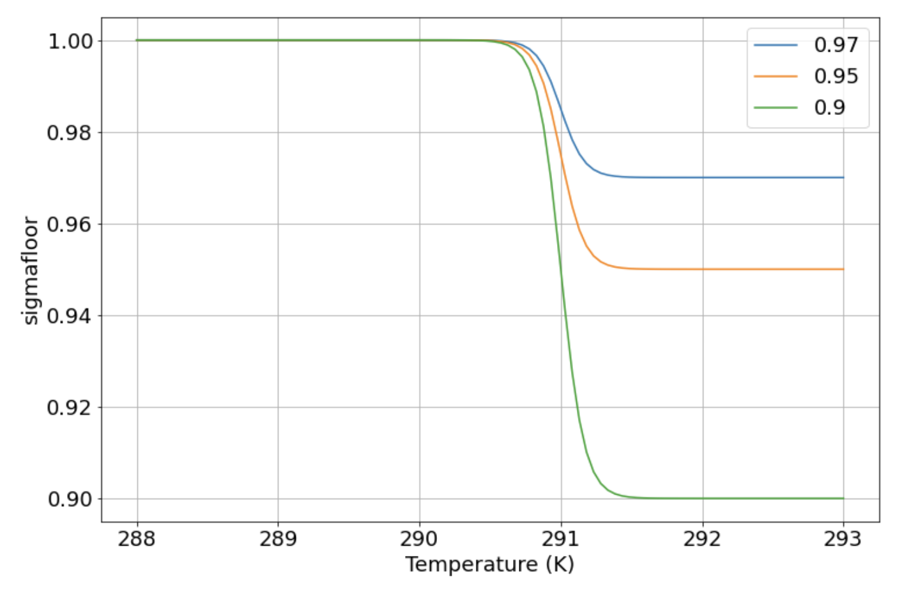
To implement certain kinds of feedbacks, we’ll need a sigmoid function
Here’s the effect of different values of the 4th argument, “floor”

Slide 5
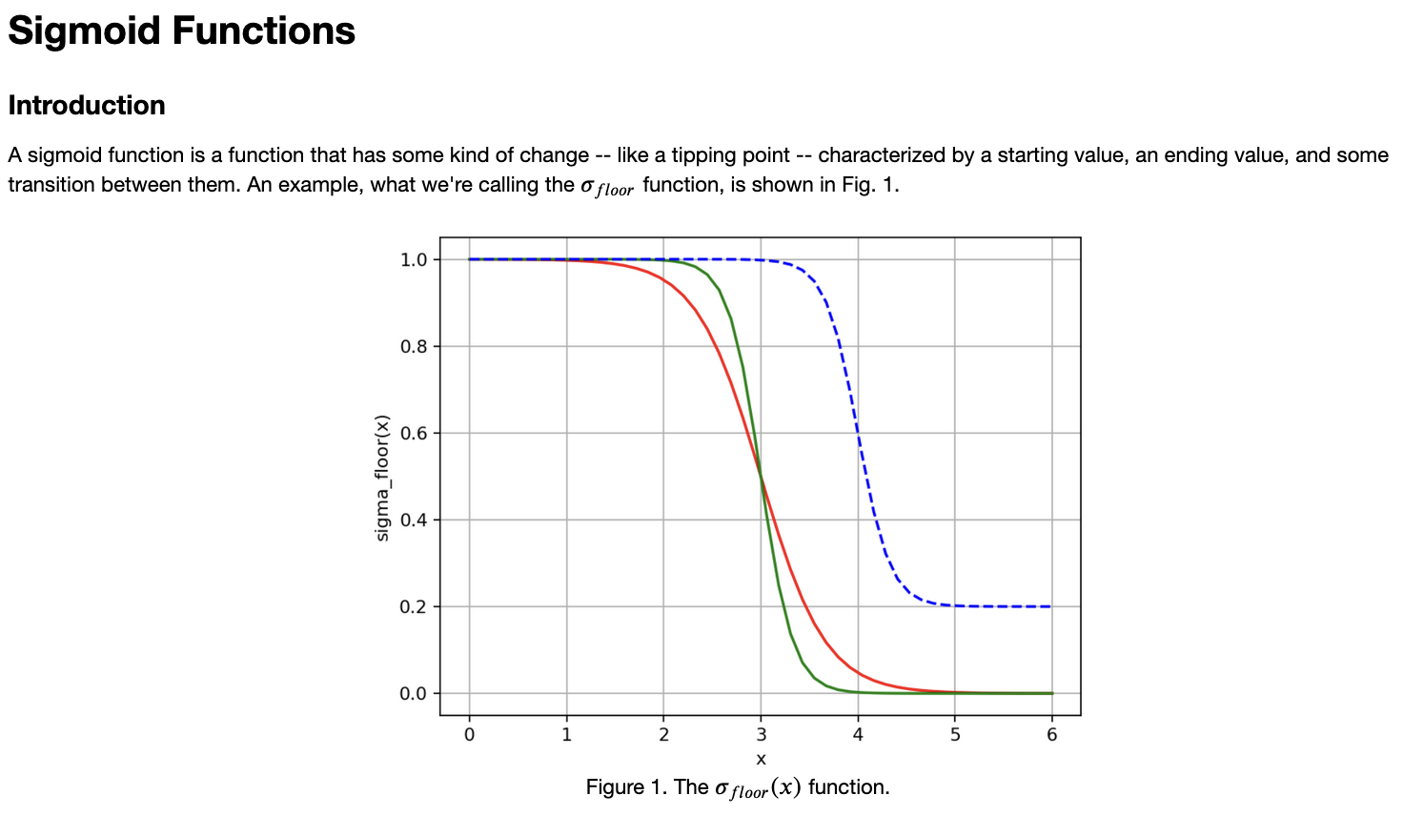
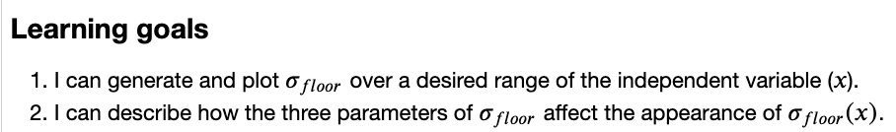
OK, let’s get started

